Slide 1

CORE JAVA Programming Tutorial

Slide 2
Agenda
Java OOPS feature – Map Interface.
Basic concept / theory.
How it works.
Examples with programs.
Interview questions.

Slide 3
Basic concept/ theory – Map Interface
It stores data in key, value fashion.
Both Key and Value should be Object type.
Each key must be unique.
Map is useful if you have to search, update or delete elements on the basis of key.
Types | Key | Value
Primitive type e.g. boolean, byte, char, short, int, float, double | Not allowed | Allowed
Non-Primitive type e.g. Byte, Short, Integer, Long, Boolean, Float, Double, String, Object, File, Employee (custom type) | Allowed | Allowed
Empty String | Allowed | Allowed
null | Allowed | Allowed
Duplicate | Not allowed (it overwrites existing) | Allowed

Slide 4
Basic concept/ theory – HashMap Interface
It is implemented using below classes:
HashMap:
It extends AbstractMap & implements Map interface.
It does not maintain order of element.
It’s methods are not synchronized i.e. non thread safe.
It is not an ordered collection type.
It does not sort it’s keys/ values.
It has following four different types of constructors
HashMap()
HashMap(Map< ? extends k, ? extends V> m)
HashMap(int capacity)
HashMap(int capacity, float fillratio)

Slide 5
Basic concept/ theory – TreeMap Interface
It is implemented using below classes:
TreeMap:
Extends AbstractMap & implements NavigableMap interface
Elements are stored in a tree structure.
Sorting operations are easy.
It has a constructor which accepts Map and generates a Map sorted on the natural order of key (or any custom sorting order defined by Comparator).

Slide 6
Basic concept/ theory – LinkedHashMap Interface
It is implemented using below classes:
LinkedHashMap:
Extends HashMap class
It maintains a linked list of entries in map in order in which they are inserted.
In other words it maintains order of elements inserted.
It has following five different constructors
LinkedHashMap()
LinkedHashMap(Map< ? extends k, ? extends V> m)
LinkedHashMap(int capacity)
LinkedHashMap(int capacity, float fillratio)
LinkedHashMap(int capacity, float fillratio, boolean order)

Slide 7
Basic concept/ theory – ConcurrentHashMap Interface
It is implemented using below classes:
ConcurrentHashMap:
Extends HashMap class
It provides better performance than Hashtable in a concurrent environment and should be preferred.

Slide 8
Basic concept/ theory – Entry Interface
It is implemented using below classes:
Entry interface:
It is a sub interface of Map interface.
It is used in co-ordination with entrySet( ) method declared by the Map interface which return a Set containing Map entries.
It supports while iterating a Map class e.g. HashMap, TreeMap etc.
It is used to access Key:Value set of a Map (objects).
It’s methods are:
Object getKey()
Object getValue()

Slide 9
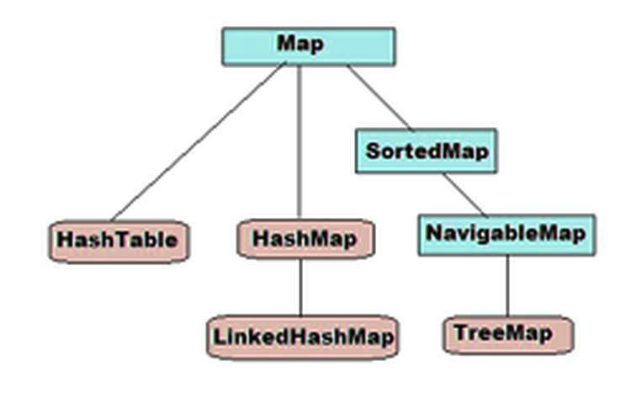

Slide 10
Map interface methods
No. | Method | Description
1 | boolean containsKey(Object k) | It returns true if map contain k as key.
2 | Object get(Object k) | It returns values associated with the key k.
3 | Object put(Object k, Object v) | It stores an entry in map.
4 | Object putAll(Map m) | It put all entries from m in this map.
5 | Object remove(Object k) | Removes the entry whose key equals k.

Slide 11
Map interface methods
No. | Method | Description
6 | Set keySet() | It returns Set that contains the key in a map.
8 | Collection values() | It returns Set that contains the value in a map.
8 | Set entrySet() | It returns Set that contains the entries in a map.
9 | Size() | Returns the number of key/value pairs in the map.
10 | Clear() | Deletes all keys and values belonging to particular object.

Slide 12
Map methods examples :
Example using HashMap.
Example using TreeMap.
Iterating over HashMap:
Example using Iterator.
Example using Map.Entry Interface.

Slide 13
Interview questions
Difference between HashMap and TreeMap -
No. | HashMap | TreeMap
1 | No guarantee of order of elements entered. | Elements are stored in ascending sorted order (according to sorted ordering).
2 | New element is just added in HashMap. | When new element is added, sorting is carried out and entire key-value pair shift may happen.
3 | Get/ Put takes O(1) time | Get/ Put takes O(log(n)) time
4 | Null key (only once) and any type of value allowed. | Null key is not allowed. Any type of value is allowed.

